Slide 1
Keck School of Medicine of USC Updating Publications on CTSI Profiles

Slide 2
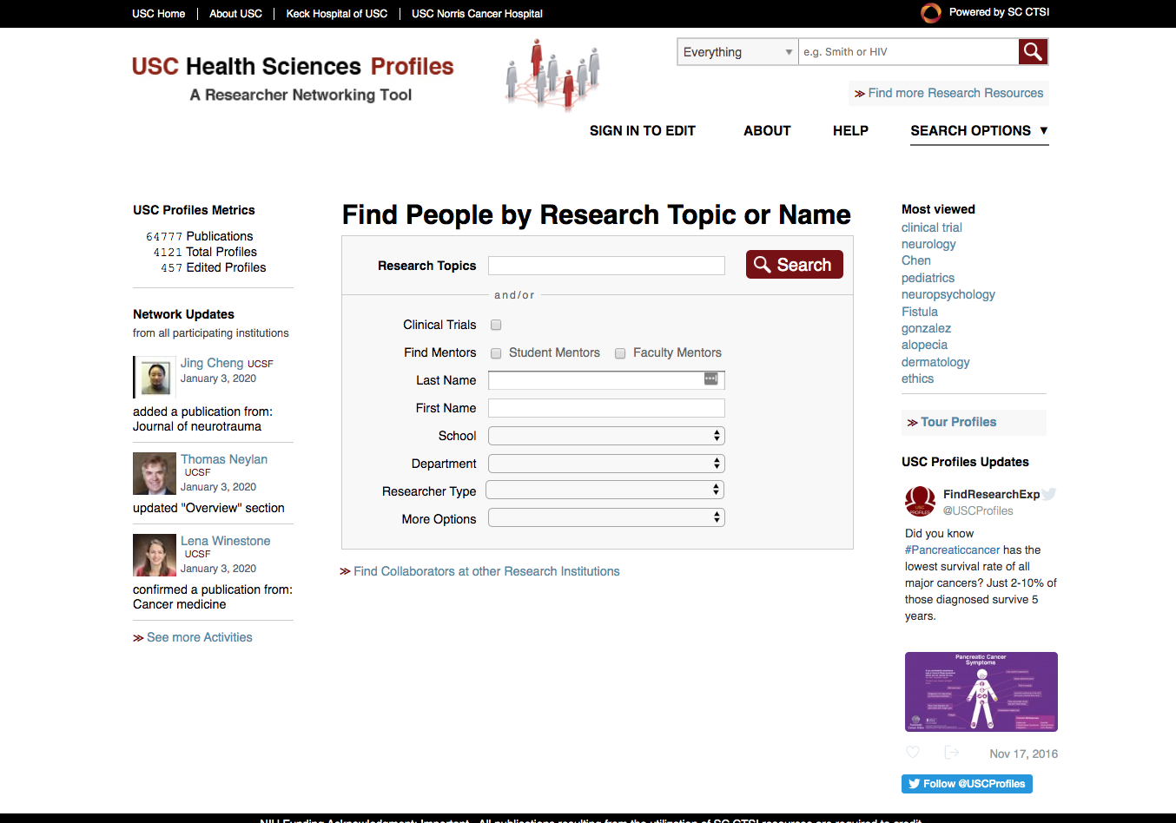
Updating Bio on your Faculty Profiles
Faculty Profile Management
Log into CTSI Profiles which powers the KSOM Faculty Profiles https://profiles.sc-ctsi.org/search/
Sign-in using your USC NetID

Slide 3
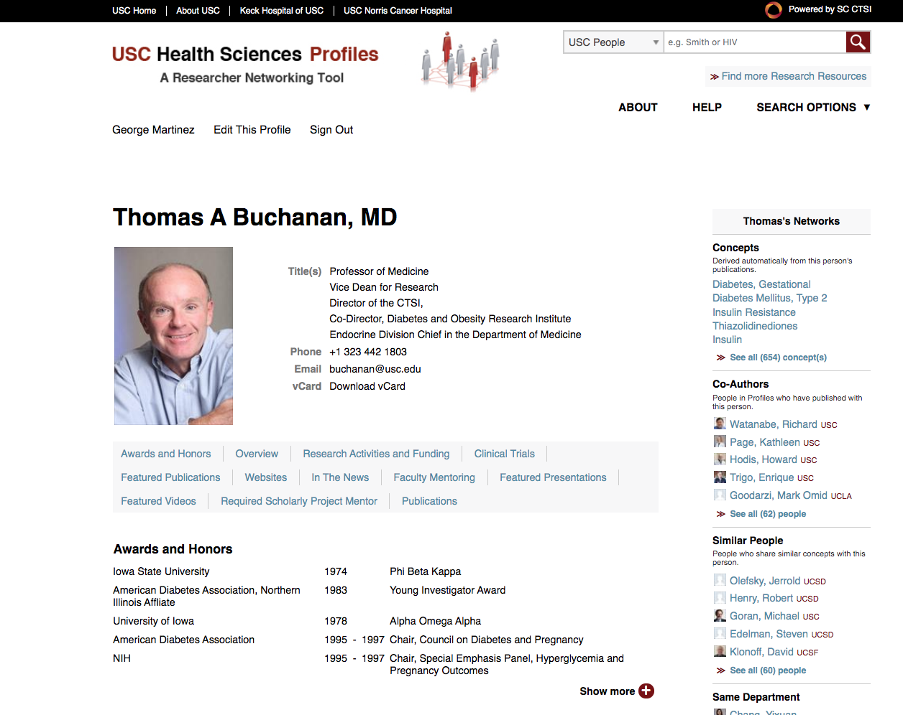
Updating Publication Listings on your Faculty Profiles
Once logged into your profile Click “Edit this profile”

Slide 4
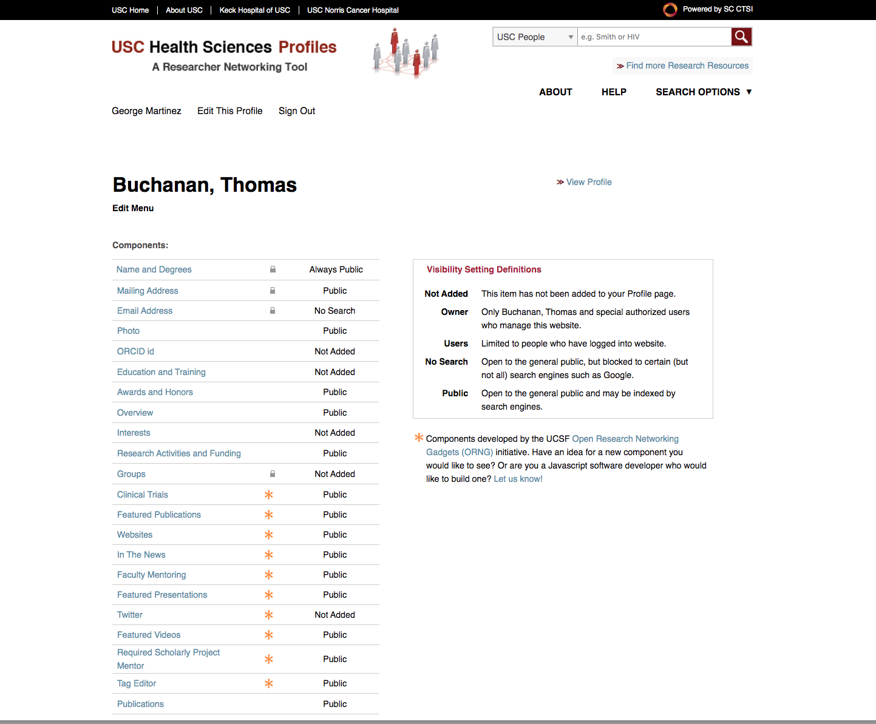
Updating Publication Listings on your Faculty Profiles
Click on “Publications” in the Edit Menu
This will take you to your publications list

Slide 5
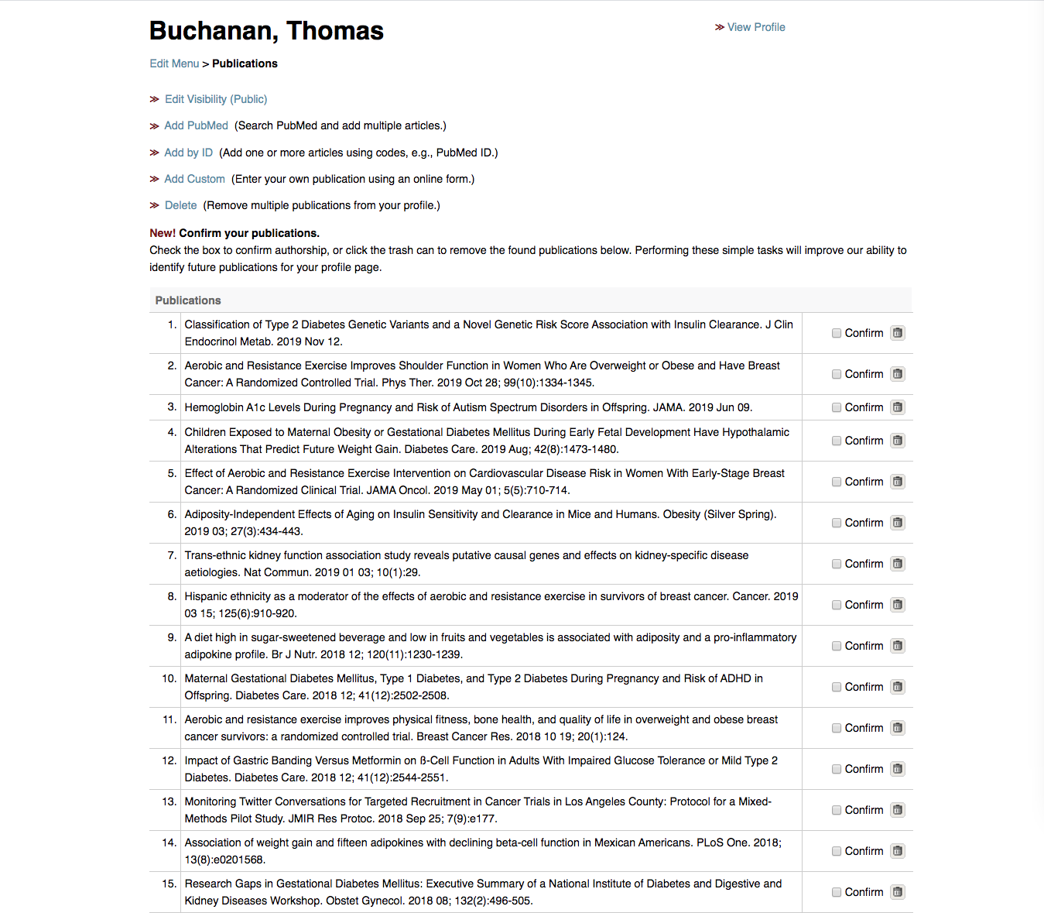
Updating Publication Listings on your Faculty Profiles
Once at your Publications list you can:
Confirm your publications
Delete any incorrect listings
* Performing these simple tasks will improve our ability to identify future publications for your profile page.

Slide 6
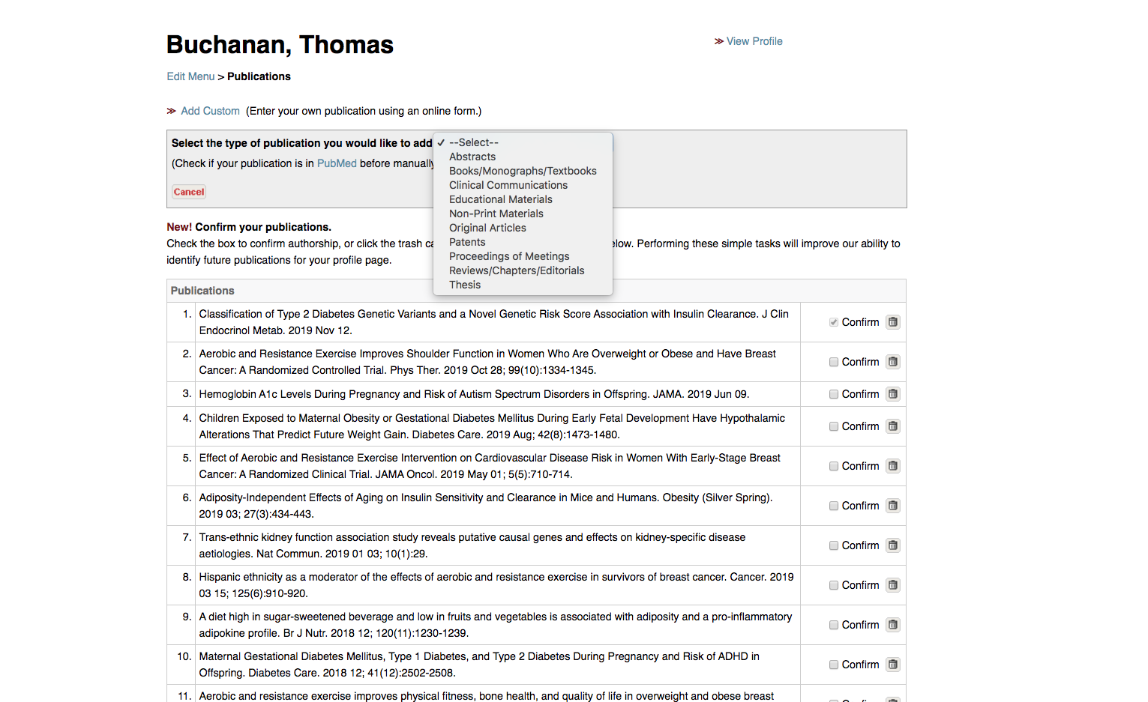
Updating Publication Listings on your Faculty Profiles
You can also add Custom Publications by clicking “Add Custom”
Then select the type of publication from the drop down

Slide 7
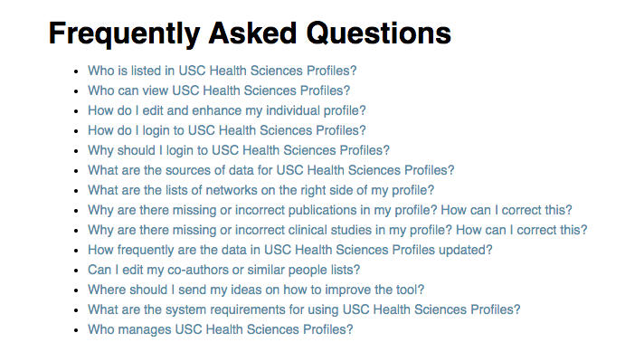
Updating Publication Listings on your Faculty Profiles
For additional Assistance
Visit the CTSI Profiles FAQ
Contact the Profiles team

