Slide 1
Keck School of Medicine of USC Updating Your Bio on CTSI Profiles

Slide 2
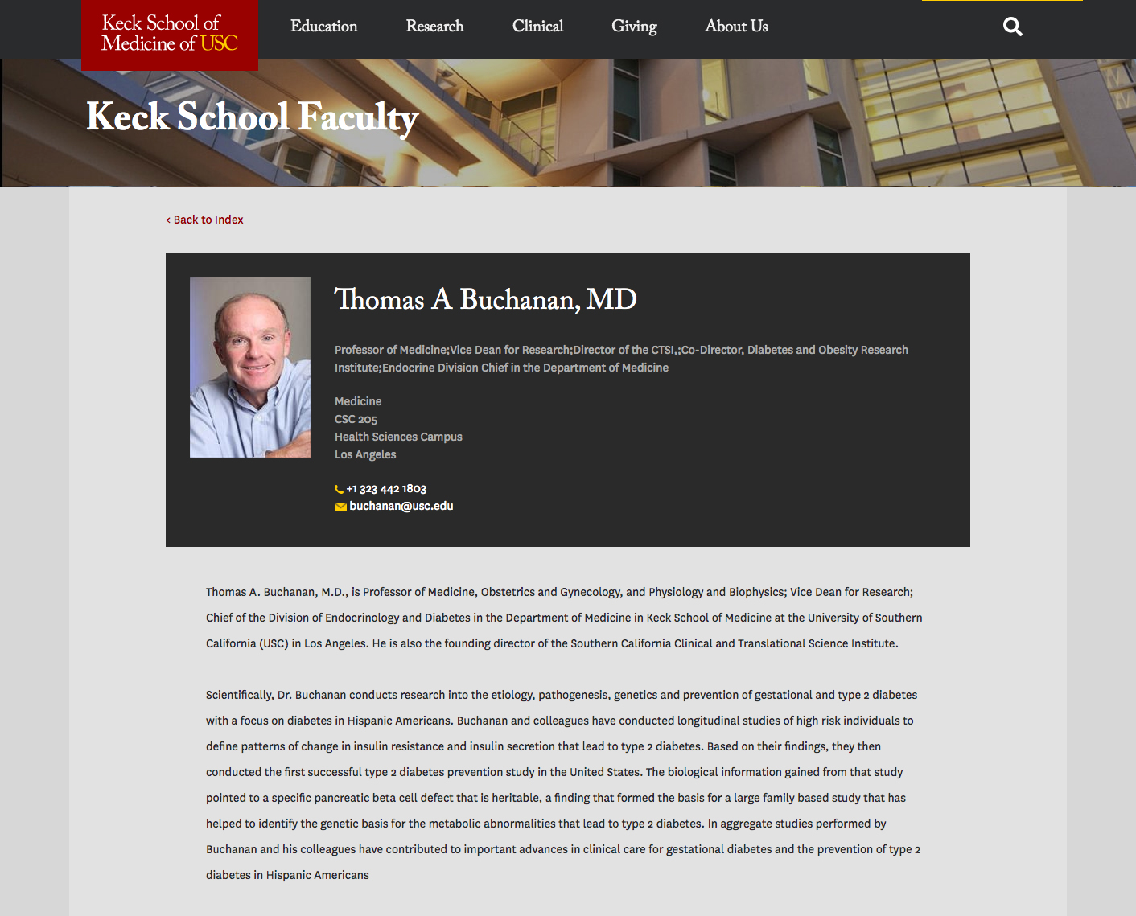
Updating Bio on your Faculty Profiles
Updating Contact information
Faculty Profiles are powered by the CTSI database
The contact information is pulled into CTSI from Workday.
Updates to address, phone, email must be made by logging into Workday and updating information in Workday

Slide 3
Updating Bio on your Faculty Profiles
Keck School Faculty Profiles
Faculty Profiles are powered by the CTSI database
Updates to your faculty bio will need to be made by logging into CTSI

Slide 4
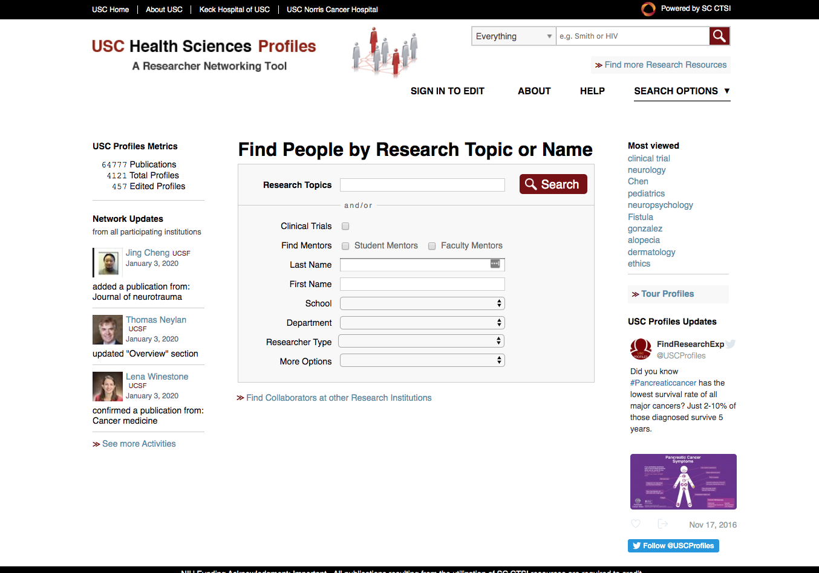
Updating Bio on your Faculty Profiles
Faculty Profile Management
Log into CTSI Profiles which powers the KSOM Faculty Profiles https://profiles.sc-ctsi.org/search/
Sign-in using your USC NetID

Slide 5
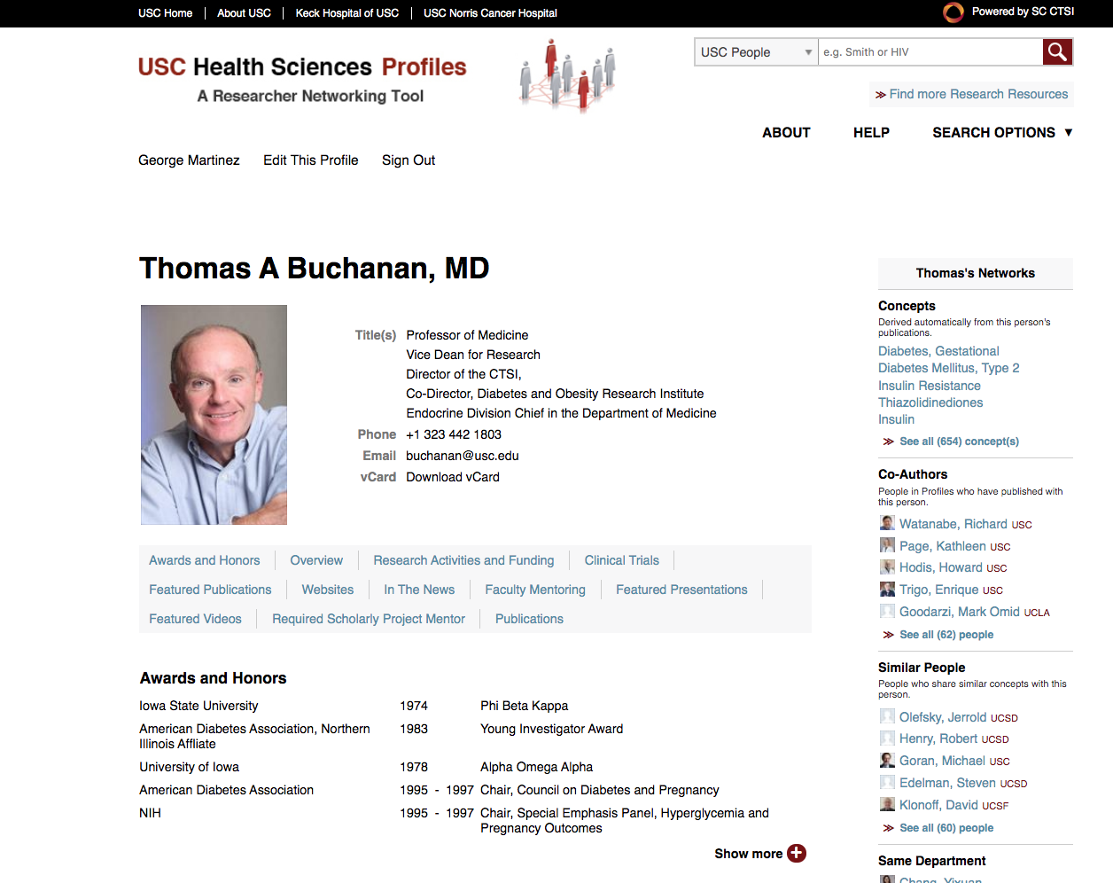
Updating Bio on your Faculty Profiles
Once logged into your profile click ‘Edit this profile’

Slide 6
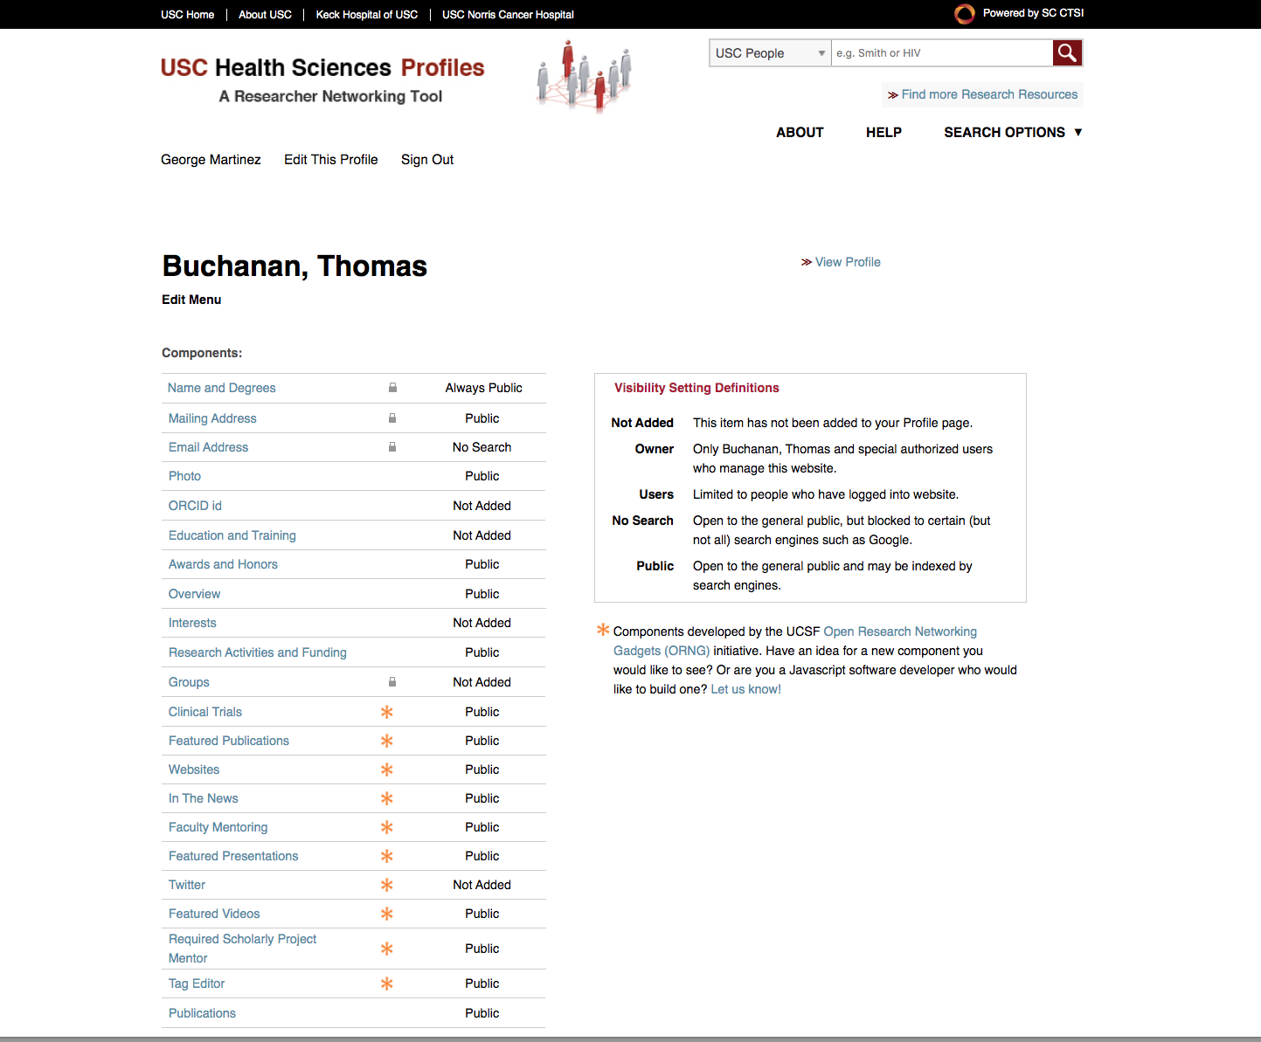
Updating Bio on your Faculty Profiles
Click on “Overview” in the Edit Menu
This will take you to your Overview

Slide 7
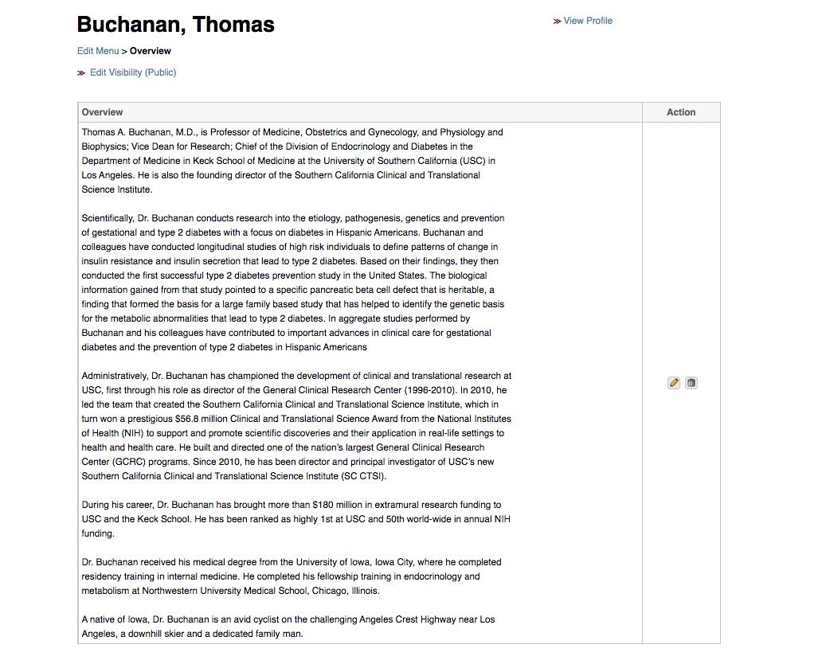
Updating Bio on your Faculty Profiles
Once at your Overview Page:
Click Edit (pencil icon)
Or Delete (trash icon)
Replace your entire Overview/Bio or make the necessary edits

Slide 8
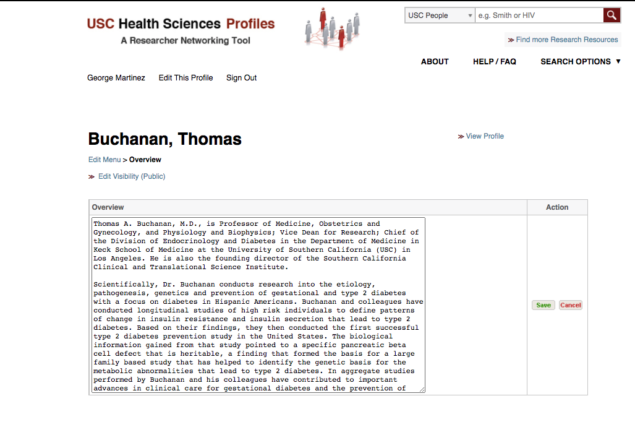
Updating Bio on your Faculty Profiles
Click “Save”
Your CTSI profile has been updated
The update will push to the KSOM profile within 48 hours.

Slide 9
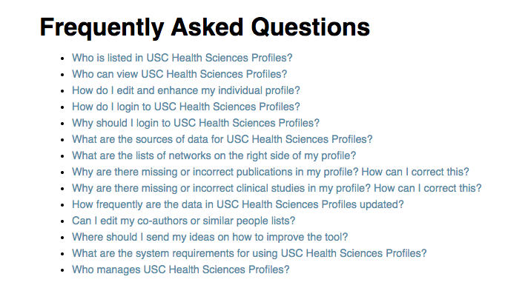
Updating Bio on your Faculty Profiles
For additional Assistance
Visit the CTSI Profiles FAQ
Contact the Profiles team

